Slide 1
The Arduino game
By Vlad, Aris and James

Slide 2
The kit list
Arduino UNO
resistor 220 Ω x2
RGB backlight positive LCD 16x2 / 18x2 works too
Breadboard - Self-Adhesive
Momentary Pushbutton Switch - 12mm Square
Jumper Wires Standard x20
USB CABLE - STANDARD A-B

Slide 3
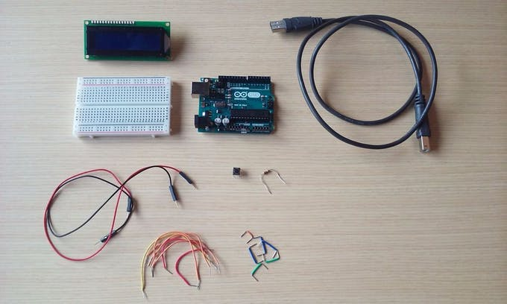

Slide 4
Here is the link code that we used
https://create.arduino.cc/projecthub/muhamd-magdy/arduino-game-by-lcd-9a3bc2?ref=tag&ref_id=games&offset=7

Slide 5
